Slide 1
Final Figures For the Paper
Code is in the github repository.
All figures should be fully editable in ppt. I think they will also copy and paste well into illustrator.

Slide 3
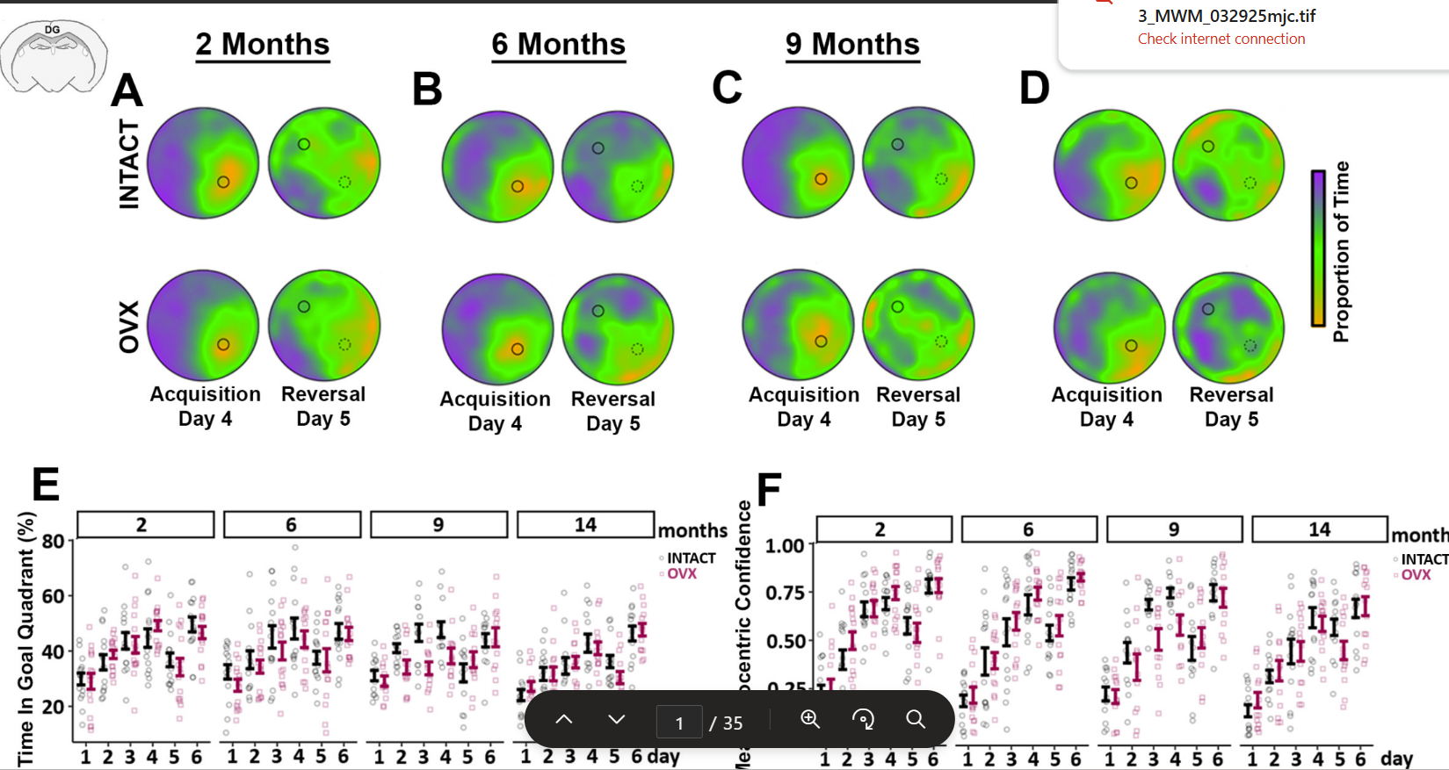

Slide 5
To do
xMake all days 1-6 and horizontal plot.
xAdd goal crossings as measure on probe.
xAdd entropy.
xAdd effect sizes.
xAdd new column that is ‘time in goal’.

Slide 6
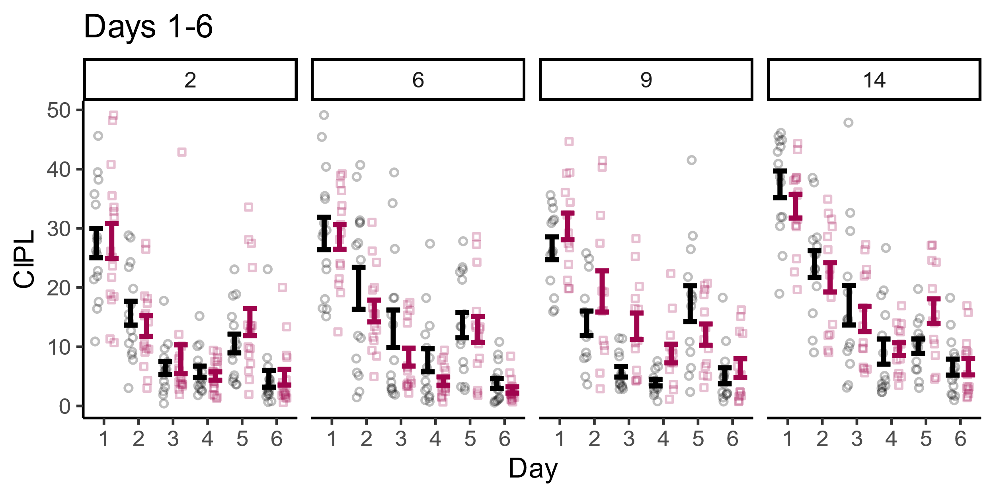
[1] "----------"
[1] "MONTH: 2"
[1] "----------"
mn_CIPL ~ Strain * day_cat + Error(animalID/(Strain * day_cat))
<environment: 0x0000019fe9653650>
Error: animalID
Df Sum Sq Mean Sq F value Pr(>F)
Strain 1 2 2.1 0.018 0.895
Residuals 29 3456 119.2
Error: animalID:day_cat
Df Sum Sq Mean Sq F value Pr(>F)
day_cat 3 9554 3185 79.311 <2e-16 ***
Strain:day_cat 3 57 19 0.472 0.702
Residuals 87 3493 40
---
Signif. codes: 0 ‘***’ 0.001 ‘**’ 0.01 ‘*’ 0.05 ‘.’ 0.1 ‘ ’ 1
# Effect Size for ANOVA (Type I)
Group | Parameter | Eta2 (partial) | 95% CI
-----------------------------------------------------------------
animalID | Strain | 6.06e-04 | [0.00, 1.00]
animalID:day_cat | day_cat | 0.73 | [0.65, 1.00]
animalID:day_cat | Strain:day_cat | 0.02 | [0.00, 1.00]
- One-sided CIs: upper bound fixed at [1.00].[1] ""
[1] "ttest d3 pbonf = 1.16262597276325"
[1] "ttest d4 pbonf = 1.1042047879389"
[1] "----------"
[1] "MONTH: 6"
[1] "----------"
mn_CIPL ~ Strain * day_cat + Error(animalID/(Strain * day_cat))
<environment: 0x0000019fe9653650>
Error: animalID
Df Sum Sq Mean Sq F value Pr(>F)
Strain 1 304 304.2 1.512 0.229
Residuals 28 5632 201.2
Error: animalID:day_cat
Df Sum Sq Mean Sq F value Pr(>F)
day_cat 3 8945 2981.7 67.561 <2e-16 ***
Strain:day_cat 3 73 24.5 0.554 0.647
Residuals 84 3707 44.1
---
Signif. codes: 0 ‘***’ 0.001 ‘**’ 0.01 ‘*’ 0.05 ‘.’ 0.1 ‘ ’ 1
# Effect Size for ANOVA (Type I)
Group | Parameter | Eta2 (partial) | 95% CI
-----------------------------------------------------------------
animalID | Strain | 0.05 | [0.00, 1.00]
animalID:day_cat | day_cat | 0.71 | [0.62, 1.00]
animalID:day_cat | Strain:day_cat | 0.02 | [0.00, 1.00]
- One-sided CIs: upper bound fixed at [1.00].[1] ""
[1] "ttest d3 pbonf = 0.378663827080653"
[1] "ttest d4 pbonf = 0.211628565952318"
[1] "----------"
[1] "MONTH: 9"
[1] "----------"
mn_CIPL ~ Strain * day_cat + Error(animalID/(Strain * day_cat))
<environment: 0x0000019fe9653650>
Error: animalID
Df Sum Sq Mean Sq F value Pr(>F)
Strain 1 764.3 764.3 8.609 0.00725 **
Residuals 24 2130.8 88.8
---
Signif. codes: 0 ‘***’ 0.001 ‘**’ 0.01 ‘*’ 0.05 ‘.’ 0.1 ‘ ’ 1
Error: animalID:day_cat
Df Sum Sq Mean Sq F value Pr(>F)
day_cat 3 7466 2488.8 57.308 <2e-16 ***
Strain:day_cat 3 55 18.3 0.421 0.739
Residuals 72 3127 43.4
---
Signif. codes: 0 ‘***’ 0.001 ‘**’ 0.01 ‘*’ 0.05 ‘.’ 0.1 ‘ ’ 1
# Effect Size for ANOVA (Type I)
Group | Parameter | Eta2 (partial) | 95% CI
-----------------------------------------------------------------
animalID | Strain | 0.26 | [0.05, 1.00]
animalID:day_cat | day_cat | 0.70 | [0.61, 1.00]
animalID:day_cat | Strain:day_cat | 0.02 | [0.00, 1.00]
- One-sided CIs: upper bound fixed at [1.00].[1] ""
[1] "ttest d3 pbonf = 0.0111491829518487"
[1] "ttest d4 pbonf = 0.0204550441733719"
[1] "----------"
[1] "MONTH: 14"
[1] "----------"
mn_CIPL ~ Strain * day_cat + Error(animalID/(Strain * day_cat))
<environment: 0x0000019fe9653650>
Error: animalID
Df Sum Sq Mean Sq F value Pr(>F)
Strain 1 107 107.0 0.687 0.415
Residuals 26 4048 155.7
Error: animalID:day_cat
Df Sum Sq Mean Sq F value Pr(>F)
day_cat 3 10565 3522 77.352 <2e-16 ***
Strain:day_cat 3 62 21 0.453 0.716
Residuals 78 3551 46
---
Signif. codes: 0 ‘***’ 0.001 ‘**’ 0.01 ‘*’ 0.05 ‘.’ 0.1 ‘ ’ 1
# Effect Size for ANOVA (Type I)
Group | Parameter | Eta2 (partial) | 95% CI
-----------------------------------------------------------------
animalID | Strain | 0.03 | [0.00, 1.00]
animalID:day_cat | day_cat | 0.75 | [0.67, 1.00]
animalID:day_cat | Strain:day_cat | 0.02 | [0.00, 1.00]
- One-sided CIs: upper bound fixed at [1.00].[1] ""
[1] "ttest d3 pbonf = 1.12834984804516"
[1] "ttest d4 pbonf = 1.72562035119767"
To edit the figure, ungroup twice.
Stats are to the right. I highlighted the important stuff
Effect sizes are in the eta squared table. Only pay attention to Strain. Do not report effect sizes for non-significant results.
Significant posthoc: 9mo
Only performed posthoc for d3,4
All trials in a day were averaged together
Did a separate analysis for the reversal as it was a separate question.
Notes:
Water Maze Performance: CIPL scores for each age (title) and condition (INTACT vs. OVX). A mixed-design analysis of variance was performed for each age (within: day, between: condition). A main effect of day was observed for every group, and a main effect of condition was observed at 9 mo. (p = 0.00725, F = 8.61). Post hoc t-tests with Bonferroni correction were restricted to days 3 and 4 limit multiple comparisons and false negatives. Significant differences between the INTACT and OVX were observed on days 3 and 4 (Day 3: p = 0.011; Day 4: p = 0.02).

Slide 7
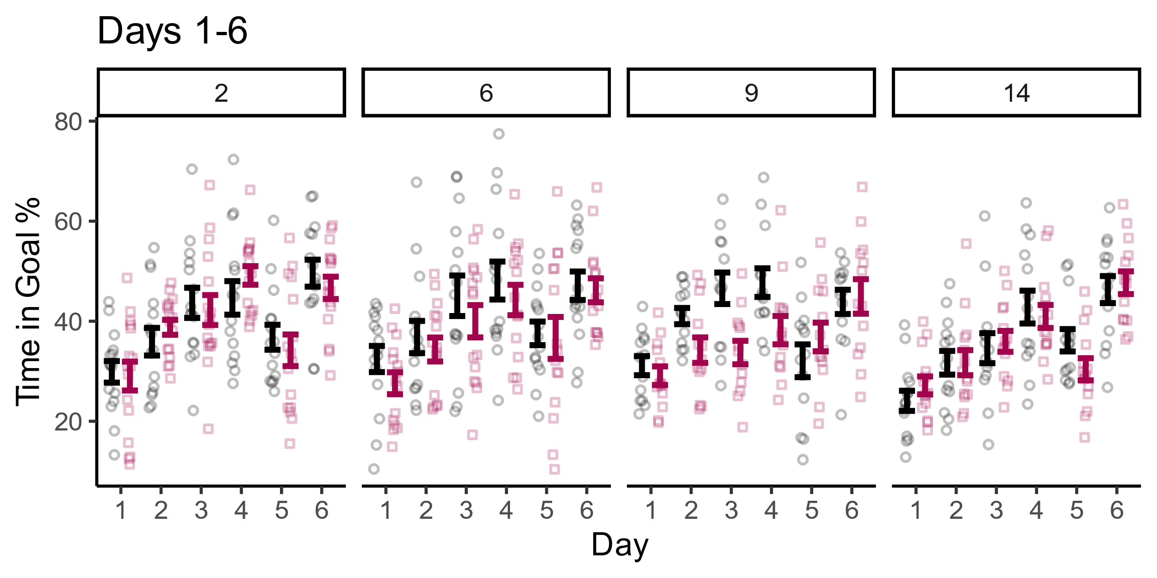
[1] "----------"
[1] "MONTH: 2"
[1] "----------"
mn_TIG ~ Strain * day_cat + Error(animalID/(Strain * day_cat))
<environment: 0x0000019fcb032578>
Error: animalID
Df Sum Sq Mean Sq F value Pr(>F)
Strain 1 50 49.97 0.327 0.572
Residuals 29 4430 152.76
Error: animalID:day_cat
Df Sum Sq Mean Sq F value Pr(>F)
day_cat 3 5359 1786.5 19.582 8.67e-10 ***
Strain:day_cat 3 191 63.7 0.698 0.556
Residuals 87 7937 91.2
---
Signif. codes: 0 ‘***’ 0.001 ‘**’ 0.01 ‘*’ 0.05 ‘.’ 0.1 ‘ ’ 1
# Effect Size for ANOVA (Type I)
Group | Parameter | Eta2 (partial) | 95% CI
-----------------------------------------------------------------
animalID | Strain | 0.01 | [0.00, 1.00]
animalID:day_cat | day_cat | 0.40 | [0.26, 1.00]
animalID:day_cat | Strain:day_cat | 0.02 | [0.00, 1.00]
- One-sided CIs: upper bound fixed at [1.00].[1] ""
[1] "ttest d3 pbonf = 1.47580669789063"
[1] "ttest d4 pbonf = 0.509447678760966"
[1] "----------"
[1] "MONTH: 6"
[1] "----------"
mn_TIG ~ Strain * day_cat + Error(animalID/(Strain * day_cat))
<environment: 0x0000019fcb032578>
Error: animalID
Df Sum Sq Mean Sq F value Pr(>F)
Strain 1 500 499.7 2.121 0.156
Residuals 28 6596 235.6
Error: animalID:day_cat
Df Sum Sq Mean Sq F value Pr(>F)
day_cat 3 4671 1557.1 13.293 3.52e-07 ***
Strain:day_cat 3 31 10.5 0.089 0.966
Residuals 84 9840 117.1
---
Signif. codes: 0 ‘***’ 0.001 ‘**’ 0.01 ‘*’ 0.05 ‘.’ 0.1 ‘ ’ 1
# Effect Size for ANOVA (Type I)
Group | Parameter | Eta2 (partial) | 95% CI
-----------------------------------------------------------------
animalID | Strain | 0.07 | [0.00, 1.00]
animalID:day_cat | day_cat | 0.32 | [0.18, 1.00]
animalID:day_cat | Strain:day_cat | 3.18e-03 | [0.00, 1.00]
- One-sided CIs: upper bound fixed at [1.00].[1] ""
[1] "ttest d3 pbonf = 0.668480715063281"
[1] "ttest d4 pbonf = 0.861998883404826"
[1] "----------"
[1] "MONTH: 9"
[1] "----------"
mn_TIG ~ Strain * day_cat + Error(animalID/(Strain * day_cat))
<environment: 0x0000019fcb032578>
Error: animalID
Df Sum Sq Mean Sq F value Pr(>F)
Strain 1 1578 1578.3 14.25 0.000928 ***
Residuals 24 2658 110.7
---
Signif. codes: 0 ‘***’ 0.001 ‘**’ 0.01 ‘*’ 0.05 ‘.’ 0.1 ‘ ’ 1
Error: animalID:day_cat
Df Sum Sq Mean Sq F value Pr(>F)
day_cat 3 2375 791.7 11.851 2.15e-06 ***
Strain:day_cat 3 409 136.2 2.039 0.116
Residuals 72 4810 66.8
---
Signif. codes: 0 ‘***’ 0.001 ‘**’ 0.01 ‘*’ 0.05 ‘.’ 0.1 ‘ ’ 1
# Effect Size for ANOVA (Type I)
Group | Parameter | Eta2 (partial) | 95% CI
-----------------------------------------------------------------
animalID | Strain | 0.37 | [0.13, 1.00]
animalID:day_cat | day_cat | 0.33 | [0.17, 1.00]
animalID:day_cat | Strain:day_cat | 0.08 | [0.00, 1.00]
- One-sided CIs: upper bound fixed at [1.00].[1] ""
[1] "ttest d3 pbonf = 0.00696001738449424"
[1] "ttest d4 pbonf = 0.0535561653568222"
[1] "----------"
[1] "MONTH: 14"
[1] "----------"
mn_TIG ~ Strain * day_cat + Error(animalID/(Strain * day_cat))
<environment: 0x0000019fcb032578>
Error: animalID
Df Sum Sq Mean Sq F value Pr(>F)
Strain 1 12 11.84 0.063 0.804
Residuals 26 4884 187.83
Error: animalID:day_cat
Df Sum Sq Mean Sq F value Pr(>F)
day_cat 3 3883 1294.4 25.466 1.38e-11 ***
Strain:day_cat 3 92 30.8 0.607 0.613
Residuals 78 3964 50.8
---
Signif. codes: 0 ‘***’ 0.001 ‘**’ 0.01 ‘*’ 0.05 ‘.’ 0.1 ‘ ’ 1
# Effect Size for ANOVA (Type I)
Group | Parameter | Eta2 (partial) | 95% CI
-----------------------------------------------------------------
animalID | Strain | 2.42e-03 | [0.00, 1.00]
animalID:day_cat | day_cat | 0.49 | [0.36, 1.00]
animalID:day_cat | Strain:day_cat | 0.02 | [0.00, 1.00]
- One-sided CIs: upper bound fixed at [1.00].[1] ""
[1] "ttest d3 pbonf = 1.42511882767027"
[1] "ttest d4 pbonf = 1.28923372164793"

Slide 8
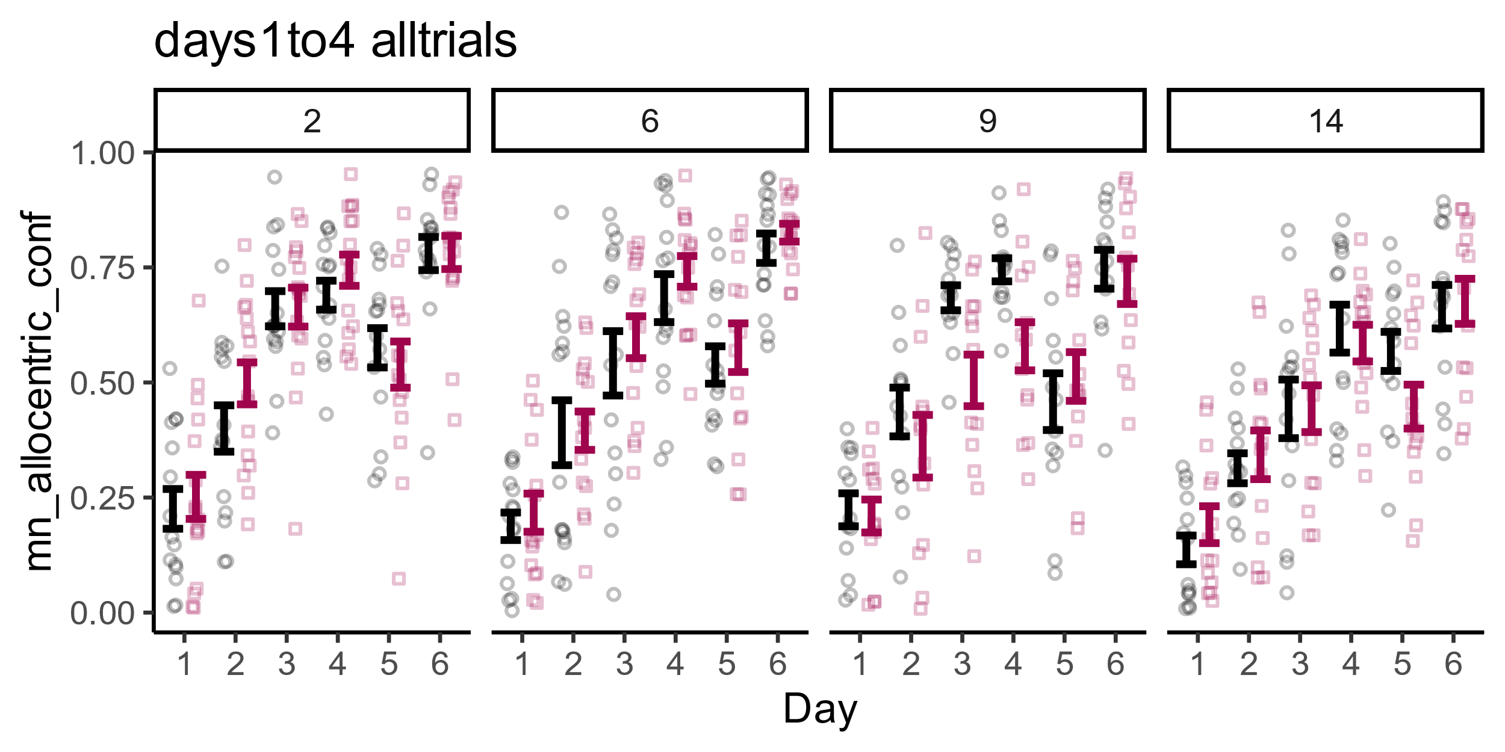
[1] "----------"
[1] "MONTH: 2"
[1] "----------"
mn_allocentric_conf ~ Strain * day_cat + Error(animalID/(Strain *
day_cat))
<environment: 0x0000019fe90503c8>
Error: animalID
Df Sum Sq Mean Sq F value Pr(>F)
Strain 1 0.0641 0.06407 1.173 0.288
Residuals 29 1.5846 0.05464
Error: animalID:day_cat
Df Sum Sq Mean Sq F value Pr(>F)
day_cat 3 4.438 1.4792 79.923 <2e-16 ***
Strain:day_cat 3 0.039 0.0129 0.696 0.557
Residuals 87 1.610 0.0185
---
Signif. codes: 0 ‘***’ 0.001 ‘**’ 0.01 ‘*’ 0.05 ‘.’ 0.1 ‘ ’ 1
# Effect Size for ANOVA (Type I)
Group | Parameter | Eta2 (partial) | 95% CI
-----------------------------------------------------------------
animalID | Strain | 0.04 | [0.00, 1.00]
animalID:day_cat | day_cat | 0.73 | [0.65, 1.00]
animalID:day_cat | Strain:day_cat | 0.02 | [0.00, 1.00]
- One-sided CIs: upper bound fixed at [1.00].[1] ""
[1] "ttest d3 pbonf = 1.90452883430752"
[1] "ttest d4 pbonf = 0.501111016677973"
[1] "----------"
[1] "MONTH: 6"
[1] "----------"
mn_allocentric_conf ~ Strain * day_cat + Error(animalID/(Strain *
day_cat))
<environment: 0x0000019fe90503c8>
Error: animalID
Df Sum Sq Mean Sq F value Pr(>F)
Strain 1 0.0416 0.04160 0.503 0.484
Residuals 28 2.3141 0.08265
Error: animalID:day_cat
Df Sum Sq Mean Sq F value Pr(>F)
day_cat 3 4.390 1.4634 64.443 <2e-16 ***
Strain:day_cat 3 0.015 0.0049 0.215 0.886
Residuals 84 1.907 0.0227
---
Signif. codes: 0 ‘***’ 0.001 ‘**’ 0.01 ‘*’ 0.05 ‘.’ 0.1 ‘ ’ 1
# Effect Size for ANOVA (Type I)
Group | Parameter | Eta2 (partial) | 95% CI
-----------------------------------------------------------------
animalID | Strain | 0.02 | [0.00, 1.00]
animalID:day_cat | day_cat | 0.70 | [0.61, 1.00]
animalID:day_cat | Strain:day_cat | 7.62e-03 | [0.00, 1.00]
- One-sided CIs: upper bound fixed at [1.00].[1] ""
[1] "ttest d3 pbonf = 1.00517500639042"
[1] "ttest d4 pbonf = 0.713164109053919"
[1] "----------"
[1] "MONTH: 9"
[1] "----------"
mn_allocentric_conf ~ Strain * day_cat + Error(animalID/(Strain *
day_cat))
<environment: 0x0000019fe90503c8>
Error: animalID
Df Sum Sq Mean Sq F value Pr(>F)
Strain 1 0.3057 0.30567 6.374 0.0186 *
Residuals 24 1.1509 0.04795
---
Signif. codes: 0 ‘***’ 0.001 ‘**’ 0.01 ‘*’ 0.05 ‘.’ 0.1 ‘ ’ 1
Error: animalID:day_cat
Df Sum Sq Mean Sq F value Pr(>F)
day_cat 3 3.1592 1.0531 49.314 <2e-16 ***
Strain:day_cat 3 0.1208 0.0403 1.885 0.14
Residuals 72 1.5375 0.0214
---
Signif. codes: 0 ‘***’ 0.001 ‘**’ 0.01 ‘*’ 0.05 ‘.’ 0.1 ‘ ’ 1
# Effect Size for ANOVA (Type I)
Group | Parameter | Eta2 (partial) | 95% CI
-----------------------------------------------------------------
animalID | Strain | 0.21 | [0.02, 1.00]
animalID:day_cat | day_cat | 0.67 | [0.57, 1.00]
animalID:day_cat | Strain:day_cat | 0.07 | [0.00, 1.00]
- One-sided CIs: upper bound fixed at [1.00].[1] ""
[1] "ttest d3 pbonf = 0.0203263322314245"
[1] "ttest d4 pbonf = 0.0210897503779497"
[1] "----------"
[1] "MONTH: 14"
[1] "----------"
mn_allocentric_conf ~ Strain * day_cat + Error(animalID/(Strain *
day_cat))
<environment: 0x0000019fe90503c8>
Error: animalID
Df Sum Sq Mean Sq F value Pr(>F)
Strain 1 0.0049 0.00488 0.077 0.783
Residuals 26 1.6389 0.06304
Error: animalID:day_cat
Df Sum Sq Mean Sq F value Pr(>F)
day_cat 3 2.8663 0.9554 49.012 <2e-16 ***
Strain:day_cat 3 0.0291 0.0097 0.497 0.686
Residuals 78 1.5205 0.0195
---
Signif. codes: 0 ‘***’ 0.001 ‘**’ 0.01 ‘*’ 0.05 ‘.’ 0.1 ‘ ’ 1
# Effect Size for ANOVA (Type I)
Group | Parameter | Eta2 (partial) | 95% CI
-----------------------------------------------------------------
animalID | Strain | 2.97e-03 | [0.00, 1.00]
animalID:day_cat | day_cat | 0.65 | [0.55, 1.00]
animalID:day_cat | Strain:day_cat | 0.02 | [0.00, 1.00]
- One-sided CIs: upper bound fixed at [1.00].[1] ""
[1] "ttest d3 pbonf = 1.99360201922465"
[1] "ttest d4 pbonf = 1.26988416594236"
Meaning: This is an improved measure of strategy where we used the calculated probability of animals selecting an allocentric strategy (dir path, dir search, corrected path). The old way was to ignore the probability and only select the ‘winning’ strategy, essentially eliminating a lot of information.
Also, the effect was strongest for the corrected path strategy within the allocentric strategies. Not sure if this is worth describing,
There was a clear effect for 9mo animals. Post hoc tests for d3 and d4 also identified specific effects.

Slide 9
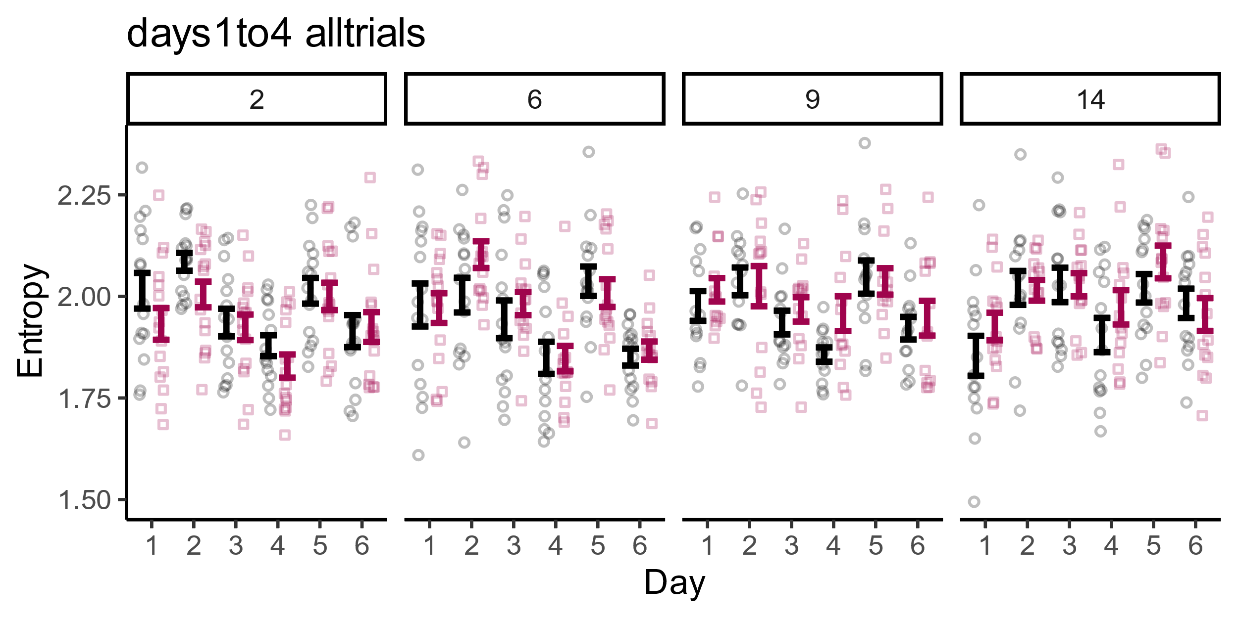
[1] "----------"
[1] "MONTH: 2"
[1] "----------"
mn_entropy ~ Strain * day_cat + Error(animalID/(Strain * day_cat))
<environment: 0x0000019fe28bba50>
Error: animalID
Df Sum Sq Mean Sq F value Pr(>F)
Strain 1 0.0667 0.06674 1.507 0.23
Residuals 29 1.2844 0.04429
Error: animalID:day_cat
Df Sum Sq Mean Sq F value Pr(>F)
day_cat 5 0.7172 0.14345 11.756 1.49e-09 ***
Strain:day_cat 5 0.0576 0.01153 0.945 0.454
Residuals 145 1.7693 0.01220
---
Signif. codes: 0 ‘***’ 0.001 ‘**’ 0.01 ‘*’ 0.05 ‘.’ 0.1 ‘ ’ 1
# Effect Size for ANOVA (Type I)
Group | Parameter | Eta2 (partial) | 95% CI
-----------------------------------------------------------------
animalID | Strain | 0.05 | [0.00, 1.00]
animalID:day_cat | day_cat | 0.29 | [0.17, 1.00]
animalID:day_cat | Strain:day_cat | 0.03 | [0.00, 1.00]
- One-sided CIs: upper bound fixed at [1.00].[1] ""
[1] "ttest d3 pbonf = 1.60601995401343"
[1] "ttest d4 pbonf = 0.405989895885845"
[1] "----------"
[1] "MONTH: 6"
[1] "----------"
mn_entropy ~ Strain * day_cat + Error(animalID/(Strain * day_cat))
<environment: 0x0000019fe28bba50>
Error: animalID
Df Sum Sq Mean Sq F value Pr(>F)
Strain 1 0.0167 0.01671 0.532 0.472
Residuals 28 0.8802 0.03144
Error: animalID:day_cat
Df Sum Sq Mean Sq F value Pr(>F)
day_cat 5 1.0626 0.21251 12.036 1.06e-09 ***
Strain:day_cat 5 0.0779 0.01558 0.882 0.495
Residuals 140 2.4719 0.01766
---
Signif. codes: 0 ‘***’ 0.001 ‘**’ 0.01 ‘*’ 0.05 ‘.’ 0.1 ‘ ’ 1
# Effect Size for ANOVA (Type I)
Group | Parameter | Eta2 (partial) | 95% CI
-----------------------------------------------------------------
animalID | Strain | 0.02 | [0.00, 1.00]
animalID:day_cat | day_cat | 0.30 | [0.18, 1.00]
animalID:day_cat | Strain:day_cat | 0.03 | [0.00, 1.00]
- One-sided CIs: upper bound fixed at [1.00].[1] ""
[1] "ttest d3 pbonf = 0.9667863105045"
[1] "ttest d4 pbonf = 1.93967644821307"
[1] "----------"
[1] "MONTH: 9"
[1] "----------"
mn_entropy ~ Strain * day_cat + Error(animalID/(Strain * day_cat))
<environment: 0x0000019fe28bba50>
Error: animalID
Df Sum Sq Mean Sq F value Pr(>F)
Strain 1 0.0331 0.03314 0.952 0.339
Residuals 24 0.8354 0.03481
Error: animalID:day_cat
Df Sum Sq Mean Sq F value Pr(>F)
day_cat 5 0.3869 0.07738 6.169 4.01e-05 ***
Strain:day_cat 5 0.0554 0.01107 0.883 0.495
Residuals 120 1.5053 0.01254
---
Signif. codes: 0 ‘***’ 0.001 ‘**’ 0.01 ‘*’ 0.05 ‘.’ 0.1 ‘ ’ 1
# Effect Size for ANOVA (Type I)
Group | Parameter | Eta2 (partial) | 95% CI
-----------------------------------------------------------------
animalID | Strain | 0.04 | [0.00, 1.00]
animalID:day_cat | day_cat | 0.20 | [0.08, 1.00]
animalID:day_cat | Strain:day_cat | 0.04 | [0.00, 1.00]
- One-sided CIs: upper bound fixed at [1.00].[1] ""
[1] "ttest d3 pbonf = 0.893146545403143"
[1] "ttest d4 pbonf = 0.0890428136046138"
[1] "----------"
[1] "MONTH: 14"
[1] "----------"
mn_entropy ~ Strain * day_cat + Error(animalID/(Strain * day_cat))
<environment: 0x0000019fe28bba50>
Error: animalID
Df Sum Sq Mean Sq F value Pr(>F)
Strain 1 0.0345 0.03447 1.004 0.326
Residuals 26 0.8924 0.03432
Error: animalID:day_cat
Df Sum Sq Mean Sq F value Pr(>F)
day_cat 5 0.5286 0.10571 5.795 7.29e-05 ***
Strain:day_cat 5 0.0695 0.01389 0.762 0.579
Residuals 130 2.3716 0.01824
---
Signif. codes: 0 ‘***’ 0.001 ‘**’ 0.01 ‘*’ 0.05 ‘.’ 0.1 ‘ ’ 1
# Effect Size for ANOVA (Type I)
Group | Parameter | Eta2 (partial) | 95% CI
-----------------------------------------------------------------
animalID | Strain | 0.04 | [0.00, 1.00]
animalID:day_cat | day_cat | 0.18 | [0.07, 1.00]
animalID:day_cat | Strain:day_cat | 0.03 | [0.00, 1.00]
- One-sided CIs: upper bound fixed at [1.00].[1] ""
[1] "ttest d3 pbonf = 1.98915284183542"
[1] "ttest d4 pbonf = 0.528131130298049"
Noting significant for entropy. Probably not worth talking about and it’s also more complicated to explain.

Slide 10
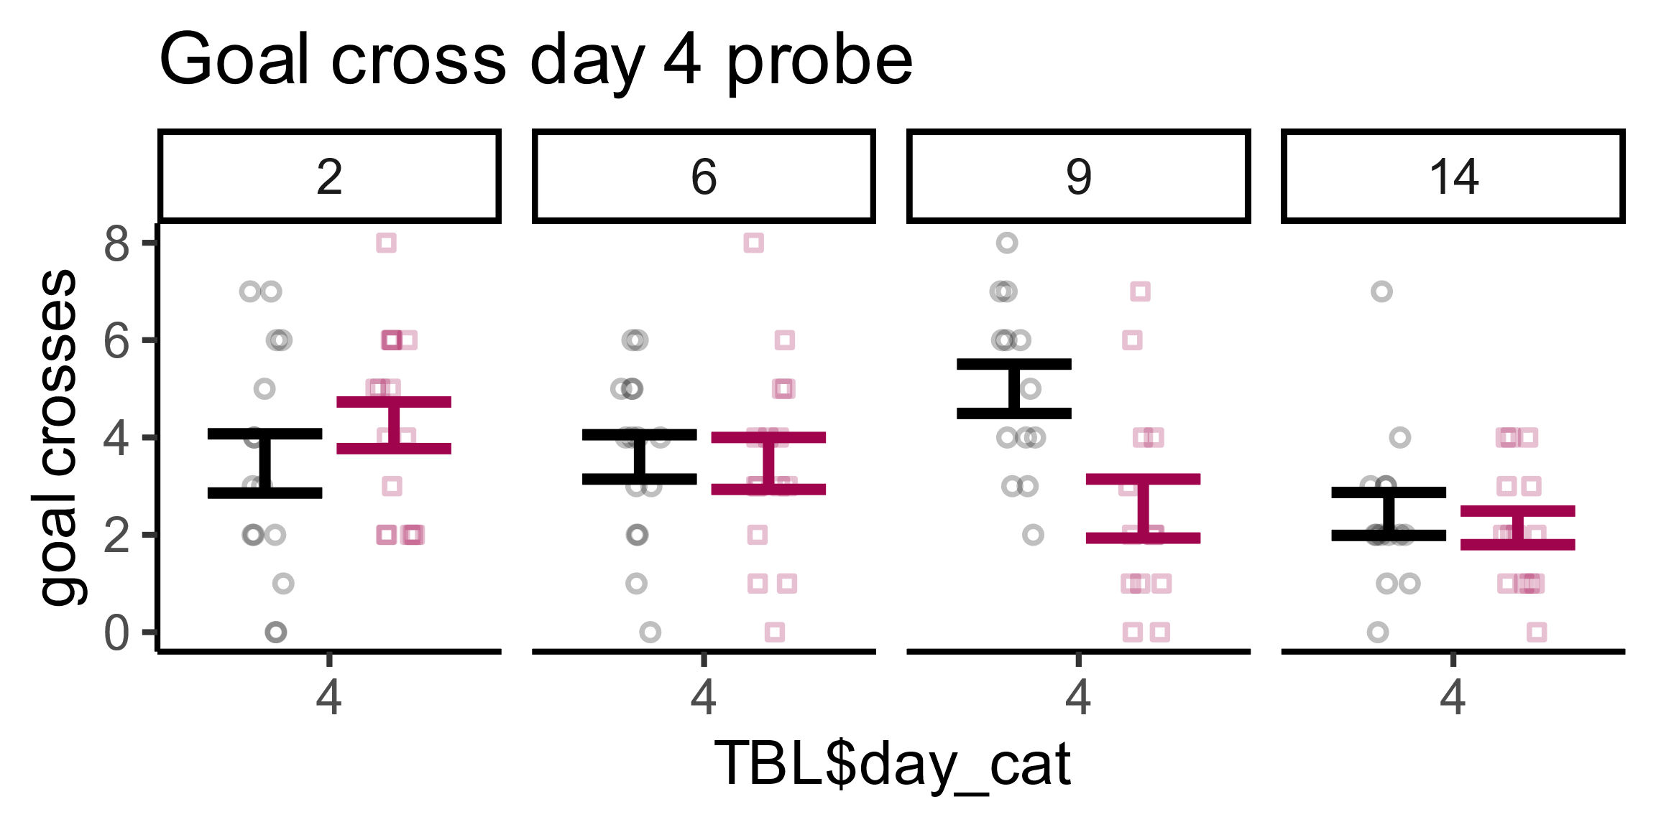
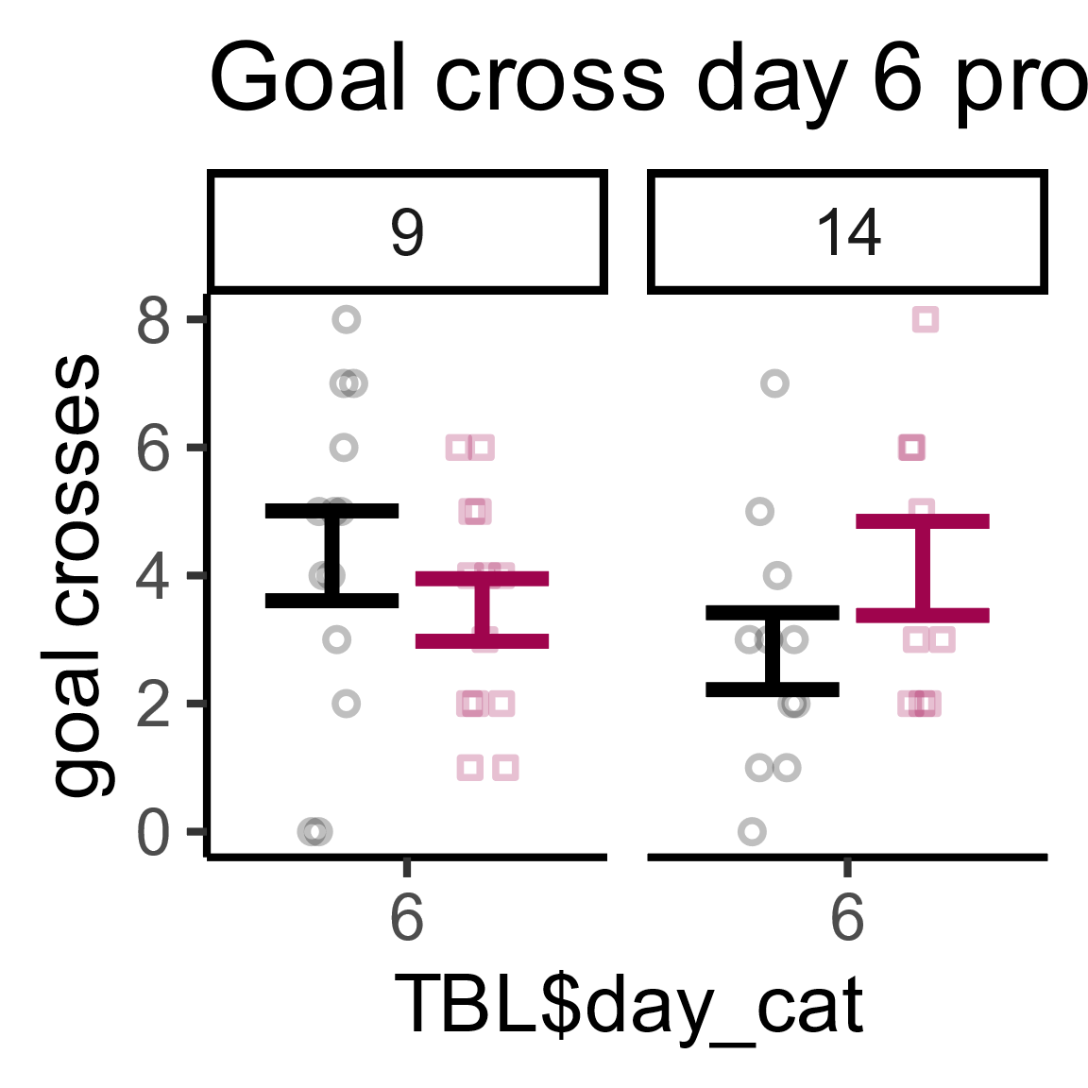
> print(paste('ttest pbonf =', t.test(sm_goal_cross~Strain,data = subset(MWM_DAY4_Probe, Age.months. == 2))$p.value))
[1] "ttest pbonf = 0.320582874092969"
> print(paste('ttest pbonf =', t.test(sm_goal_cross~Strain,data = subset(MWM_DAY4_Probe, Age.months. == 6))$p.value))
[1] "ttest pbonf = 0.850653858791209"
> print(paste('ttest pbonf =', t.test(sm_goal_cross~Strain,data = subset(MWM_DAY4_Probe, Age.months. == 9))$p.value))
[1] "ttest pbonf = 0.00479385692980433"
> print(paste('ttest pbonf =', t.test(sm_goal_cross~Strain,data = subset(MWM_DAY4_Probe, Age.months. == 14))$p.value))
[1] "ttest pbonf = 0.614667639894001“
These are uncorrected and need to be corrected: I use holm corrected, which would make 0.00479385 into 0.0191754 (as I multiplied by 4)

Slide 11
Extra given our discussion.

Slide 12
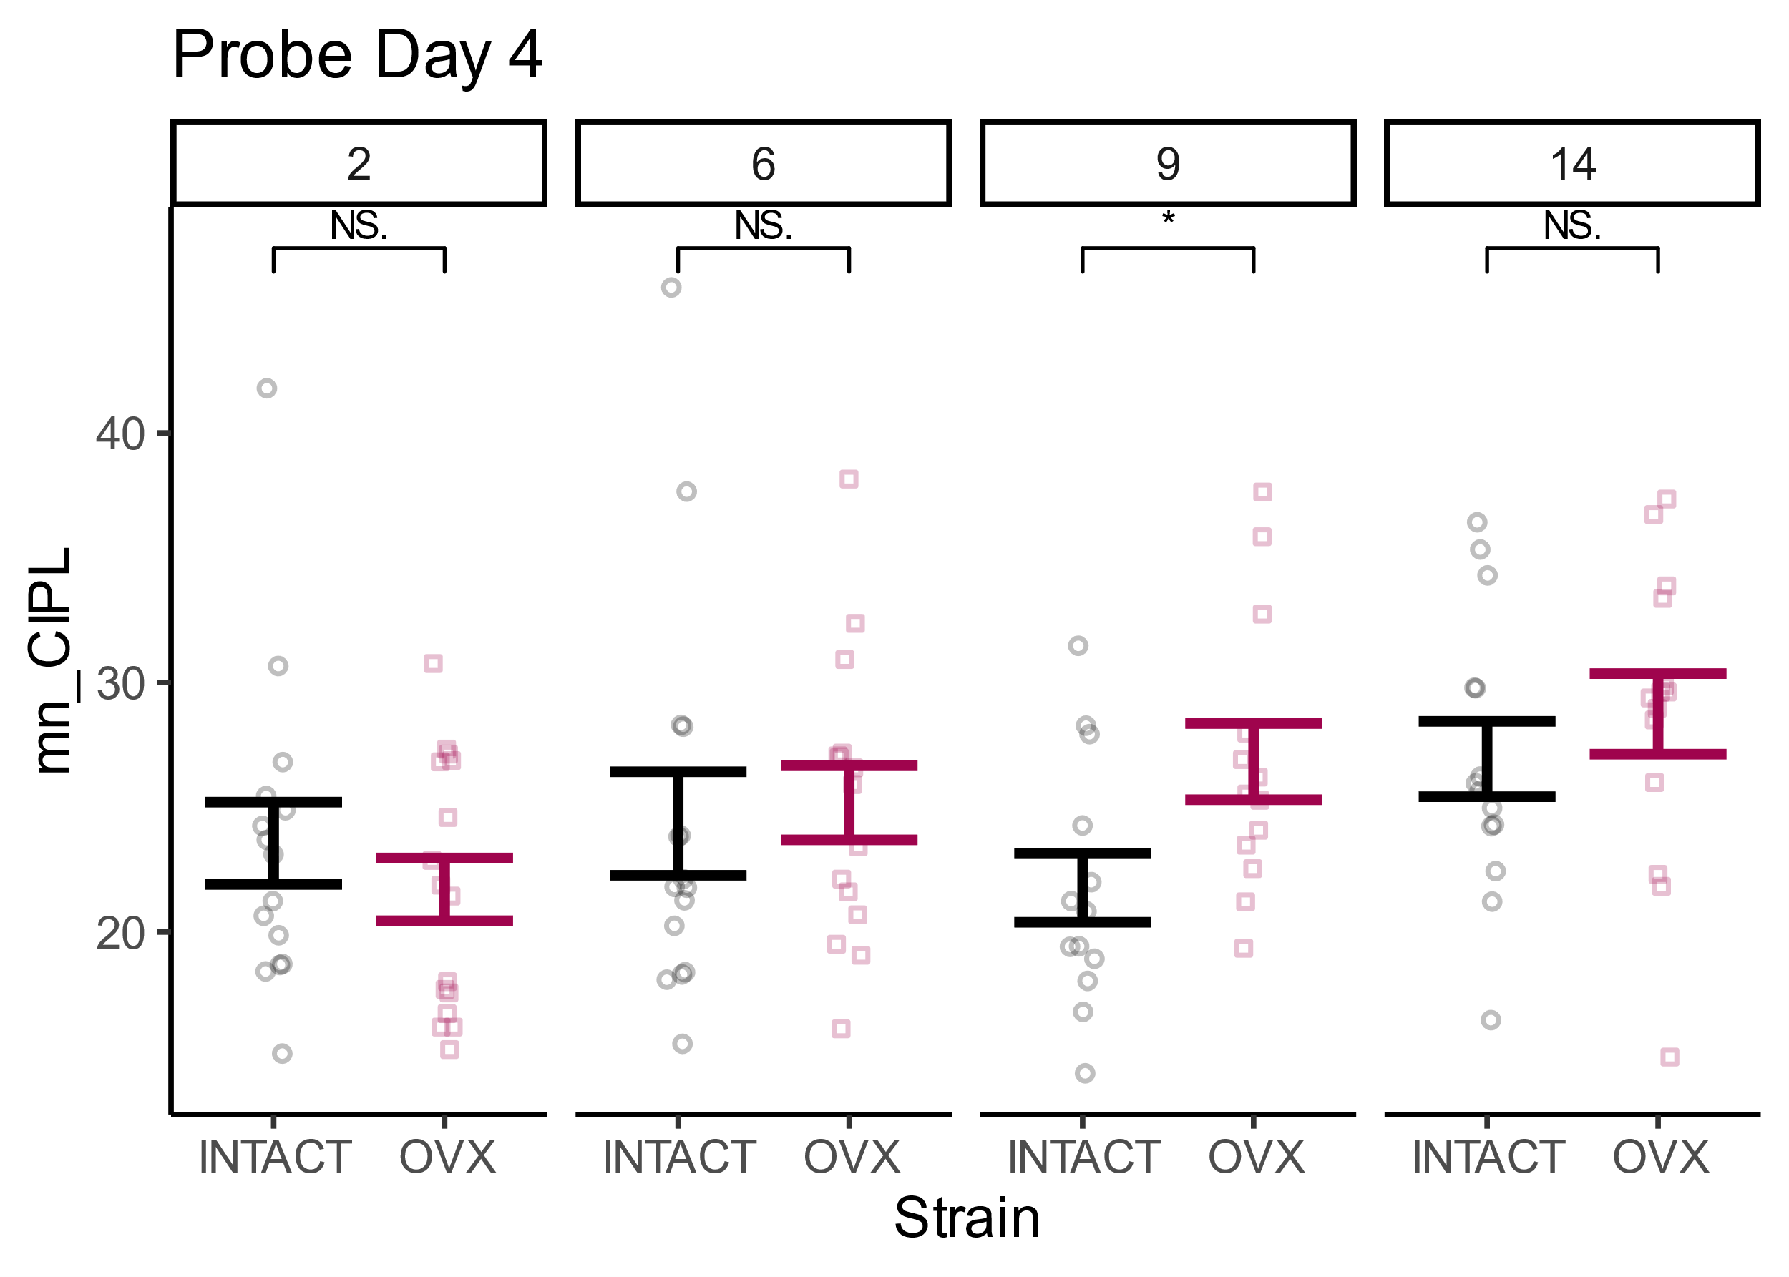
There is an effect of probe trial on 9mo even after Bonferroni.
Next slide shows its there for allocentric as well.
Uncorrected p values.. Multiply by 4 for Bonferroni.
[1] "age 2"
[1] 0.3812581
[1] "age 6"
[1] 0.7473366
[1] "age 9"
[1] 0.02132941
[1] "age 14"
[1] 0.4210218

Slide 13
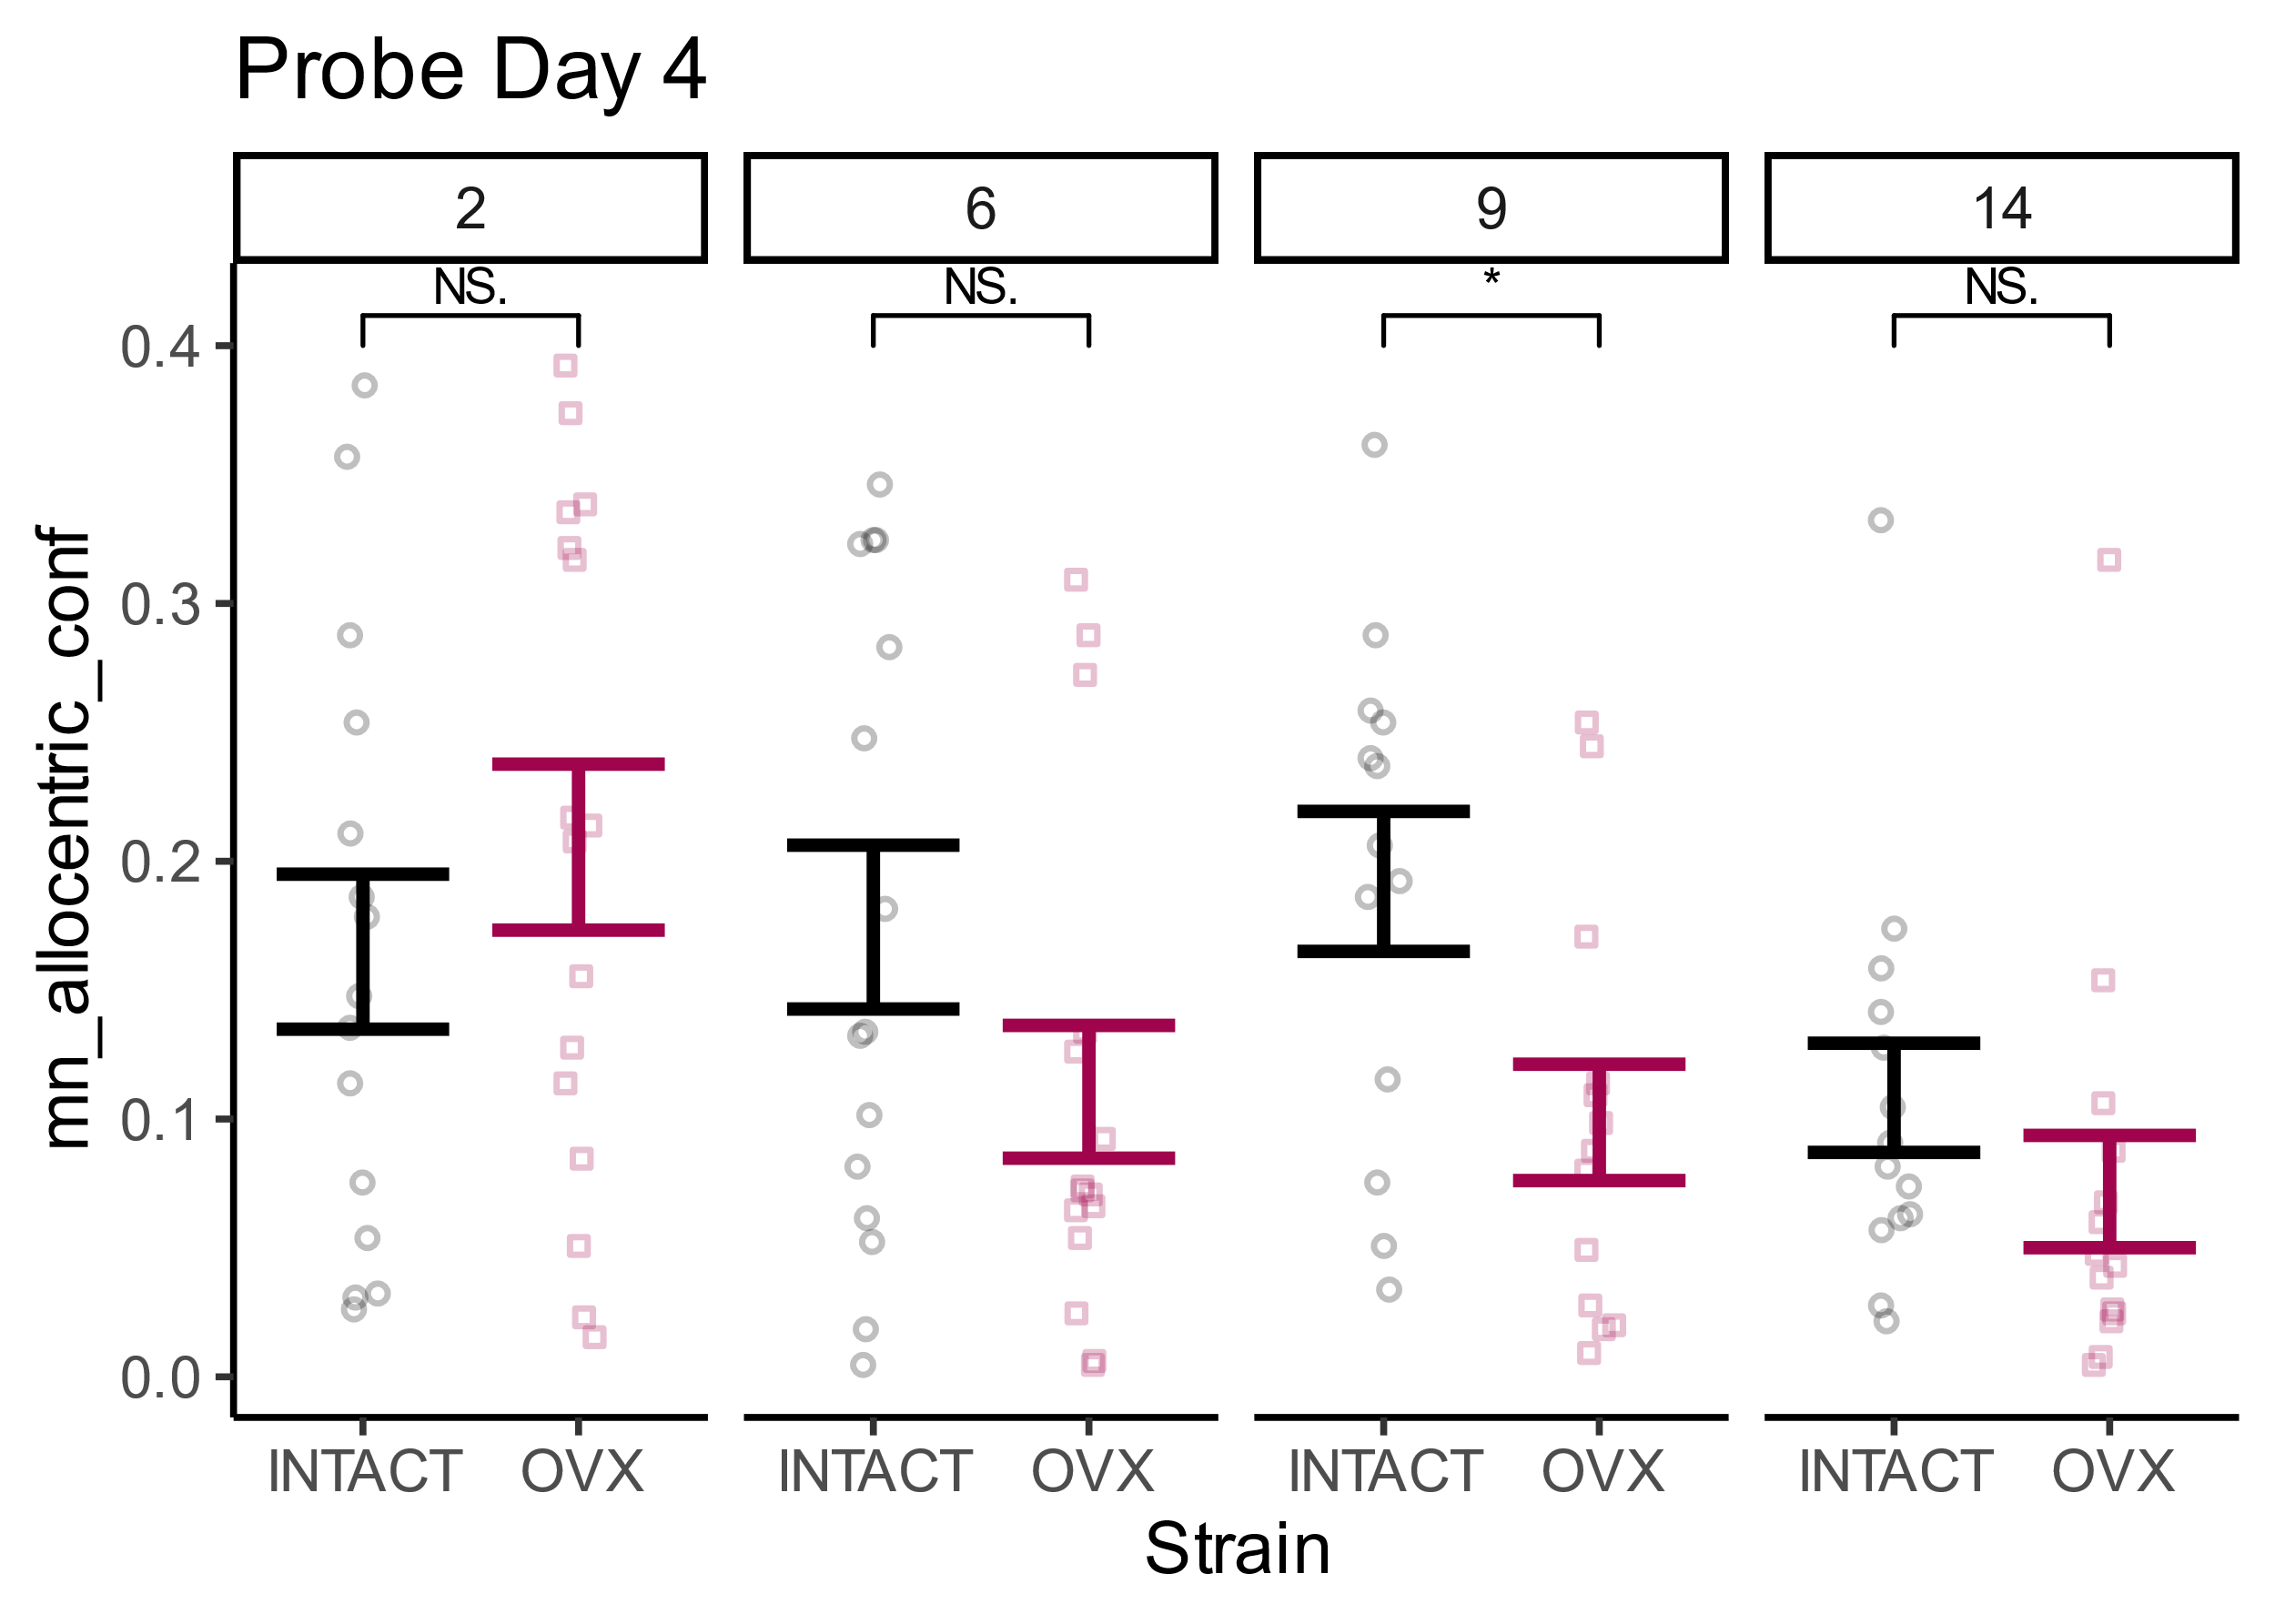
Uncorrected
[1] "age 2"
[1] 0.3648288
[1] "age 6"
[1] 0.1300082
[1] "age 9"
[1] 0.0143423
[1] "age 14"
[1] 0.2420061

Slide 14
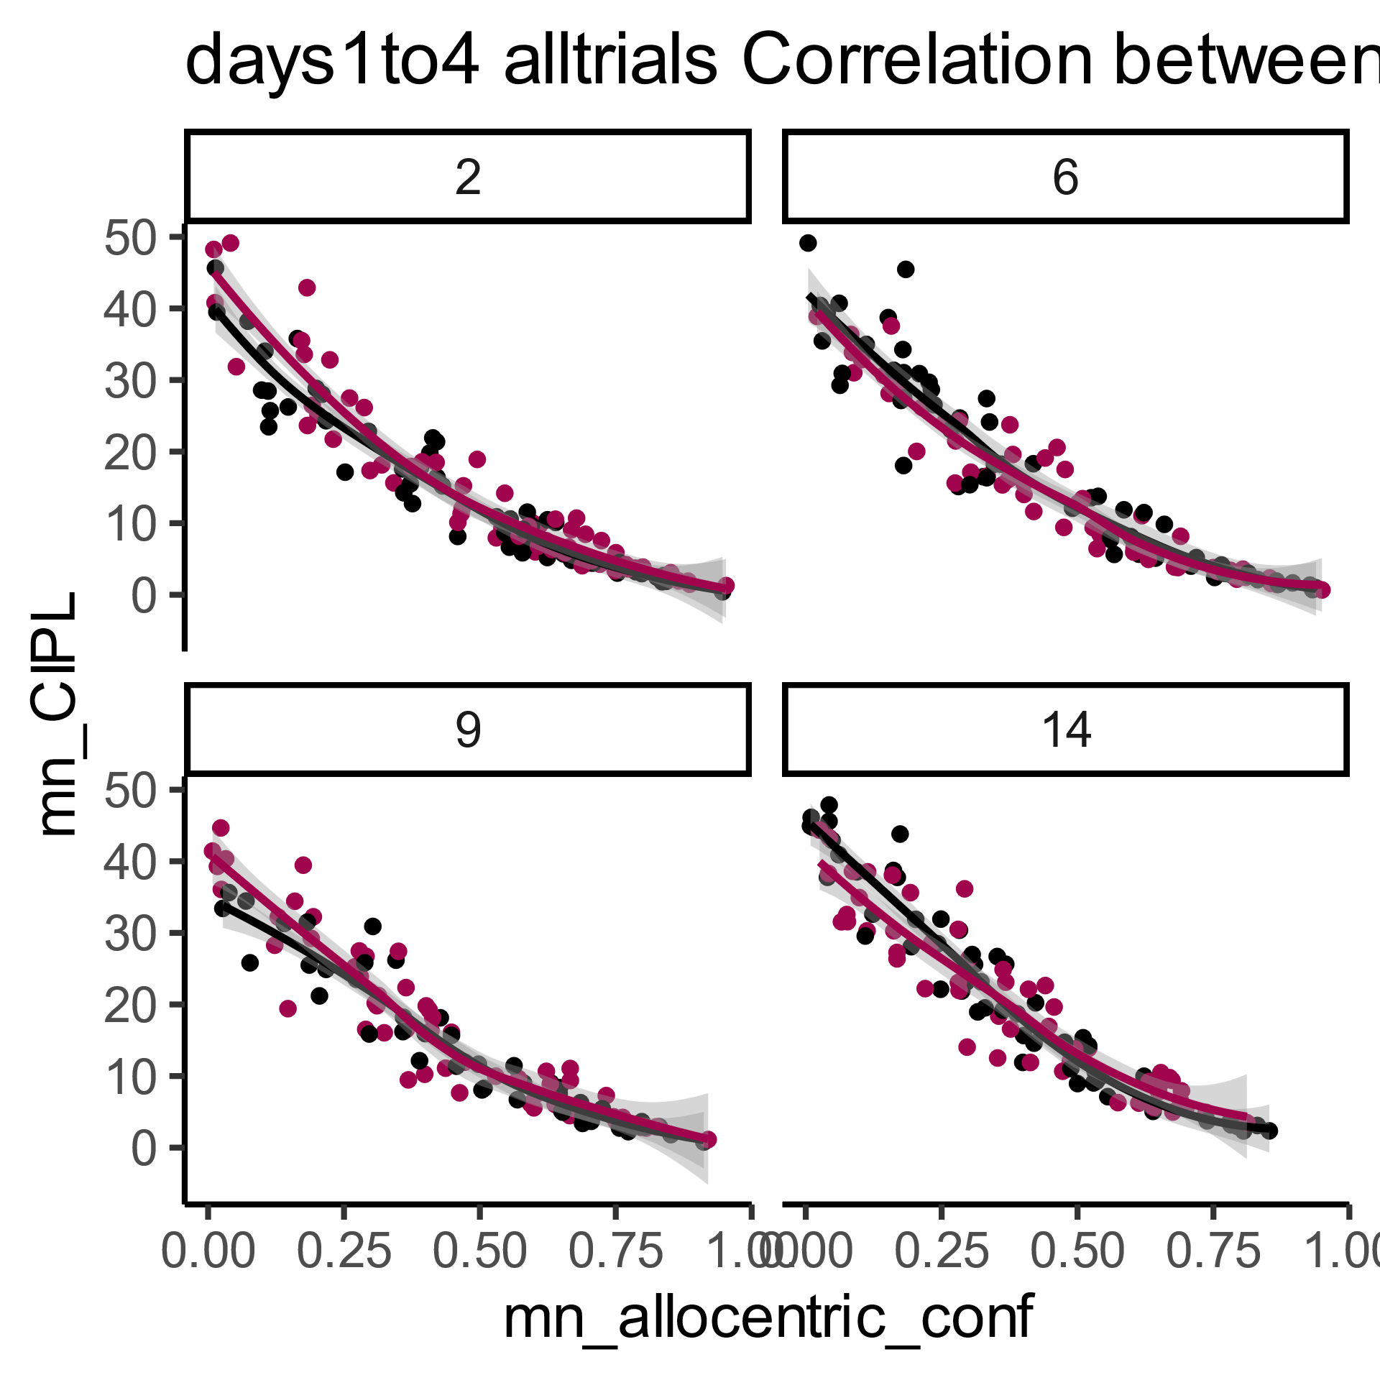
Notes:
Correlation between CIPL scores and the probability of using an allocentric strategy. An expected strong and negative relationship between CIPL scores and the likelihood of selecting an allocentric strategy.

